Slide 1


Gamifying Cloud Native: How to Design and Build an Educational Game for Your Project
Calum Murray, University of Toronto & Zainab Husain, OCAD University
In collaboration with the Perceptual Artifacts Lab and Dr Peter Coppin

Slide 2


About us
Calum Murray
Knative UX WG Lead and Eventing Maintainer
CNCF Ambassador
Engineering Science @ University of Toronto
Zainab Husain
Knative UX WG Lead
UX Course Instructor at OCAD University and Algoma University
University of Toronto, Masters in Engineering, specializing in Human Computer Interactions

Slide 3


Motivation
There are MANY abstract concepts in the cloud native space!
We wanted to create a fun, interactive way for new users to learn the abstract concepts in Knative
Specifically, we wanted to create onboarding material for Knative novices to understand what Knative Eventing is and how it works

Slide 4
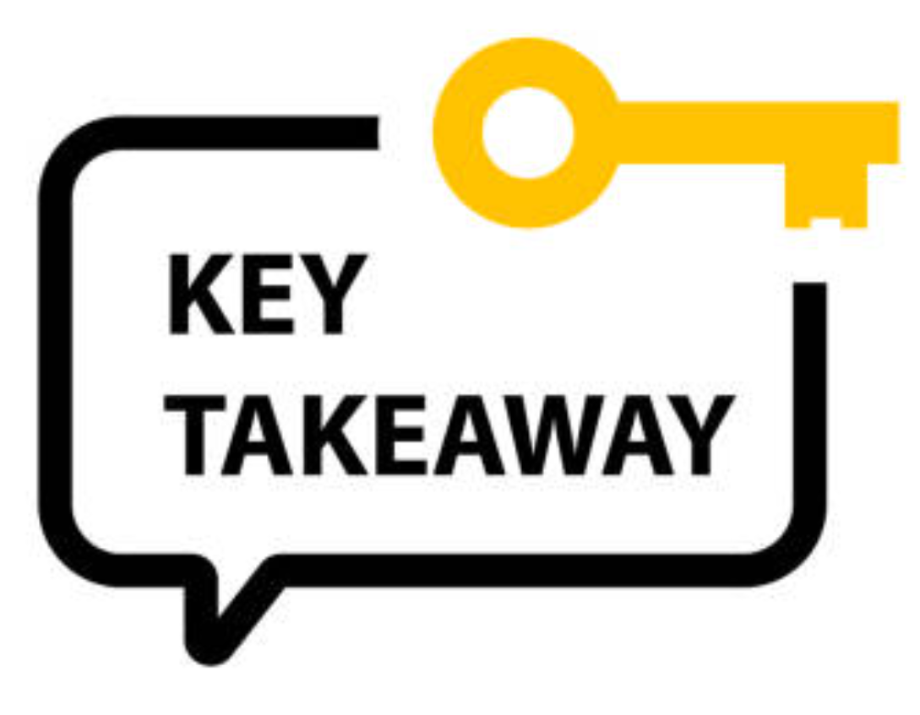
Takeaways
We will be covering:
Information design techniques
How we came up with the game concept
How we involved designers
Process of how we developed the game in open source!
Your takeaways:
How to apply information design techniques to your projects (diagrams, GUI’s etc)
How to apply collaborative design strategies (co-design) when working in interdisciplinary teams
How to develop a game (or similar prototype) for your own project!

Slide 5

Target Problem - Why
Knative Eventing provides a set of building blocks to create Event Driven Architectures in Kubernetes
Problem: Many new users have never heard of Event Driven Architecture.
How can we explain the basics of Event Driven Architecture in an intuitive way to beginners?
How can we explain how the building blocks work if they don’t understand the goal?
Came up with the idea of making a game to explain Knative Eventing

Slide 6
Demo - What
Two key resources in Knative are Brokers and Triggers
Brokers can receive events
Triggers represent connections between a broker and a subscriber to some of the events the broker receives
Want to show users how to create triggers connected to a broker so that they can receive events, as well as to introduce the concept of filtering those events

Slide 7



Video Games and Learning - Why
People like playing games!
Helps create an active learning environment [1]
Interactive, can help with knowledge retention through creating memorable experiences [2]
People like building games!
Process of creating the games results in a deeper understanding of the concepts [3]
Can be an easier small project to get involved with initially
Students and hobbyists may already have prior gave dev experience!

Slide 8

Background
Does anyone recognize this icon?

Slide 9
Background
Does anyone recognize this icon?
It's a pictorial representation of a database (abstract concept)!

Slide 10
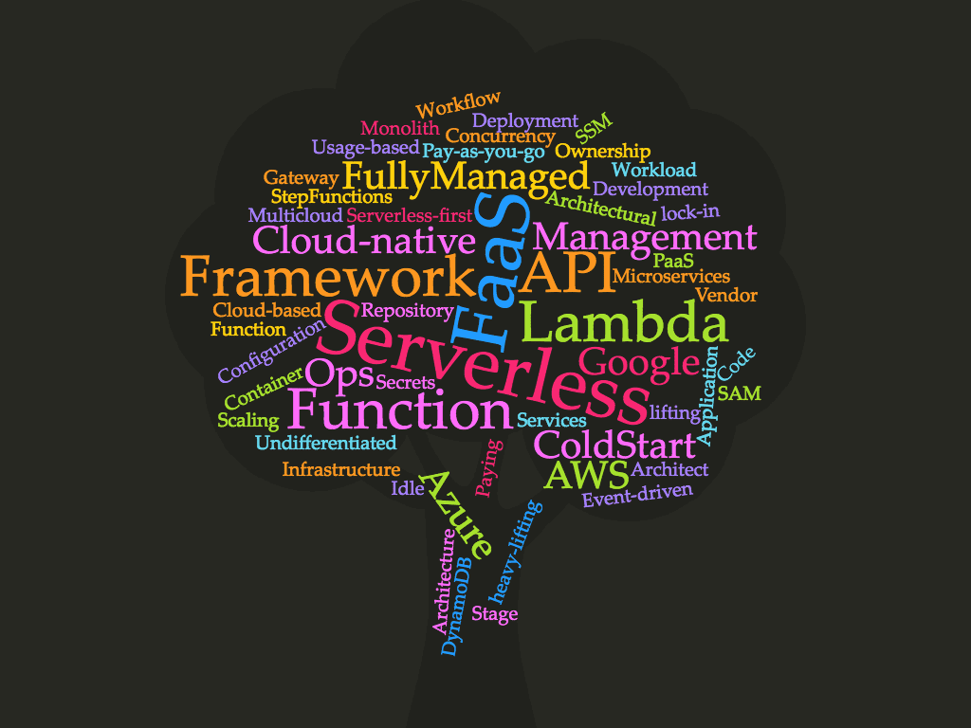
Communicating Abstract Concepts - How
Cloud Native has a lot of terminology and abstract concepts
How many times have you had trouble explaining to friends what exactly you were working on?
Learning all the domain specific language at once can be overwhelming for those new to the space
Visual representations such as icons, diagrams and pictures can help!

Slide 11


Pictorial vs Abstract representations - How
In computing, we use pictures to describe abstract concepts all the time
Analogies: You can explain an abstract concept by comparing it to something tangible
Can help make computer interfaces more familiar/intuitive
Trash bin icon - We are familiar with using a trash bin in real life, we can “throw away” a file by placing it in the trash bin icon on our computer
Concrete: Physically throwing a piece of paper away
Pictorial: Trash icon on your desktop
Abstract: Concept of removing a file from its current location
“Remove File”

Slide 12

Why do we use icons, symbols and diagrams?
Faster to recognize than text labels
Fonts, colours, screen layout are intentionally used by designers to direct attention to important information and organize information
E.g. in a Graphical User Interface (GUI) you might put related buttons in the same area
Design helps with usability, not just aesthetic
Do you recognize these symbols?
What do these buttons do?

Slide 13
How can we create representations for abstract concepts in our projects?

Slide 14


Co-design/Brainstorming
These types of projects require a variety of skill sets
Cloud Engineers, Designers, Illustrators, Game Developers etc
Co-design: Diverse skill sets stay involved throughout the design process
E.g everyone contributes ideas + feedback from the concept design to the final prototype
Brainstorms should begin with broad, open-ended discussions
Prompt questions, sticky notes for ideas, sketching etc
Don’t be afraid to draw your explanations!

Slide 15
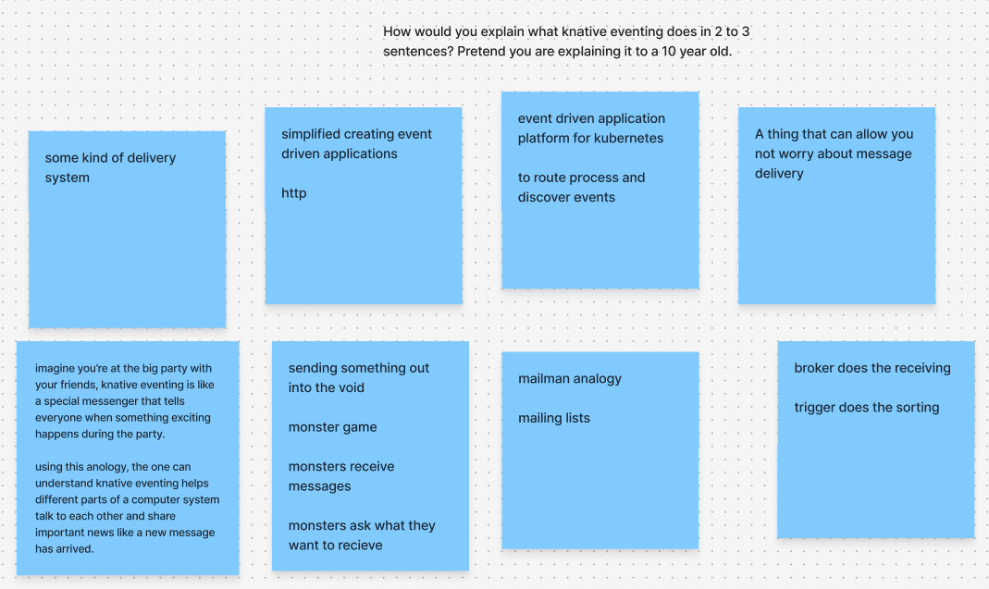
Co-design/Brainstorming - Implementation
Organized a brainstorming session, invited engineers on the Knative team and designers from OCAD University
Scheduled a meeting on zoom, used a digital whiteboard (figjam)
Brainstorming Prompt Questions: How would you explain what knative eventing does in 2 to 3 sentences? Pretend you are explaining it to a 10 year old.

Slide 16
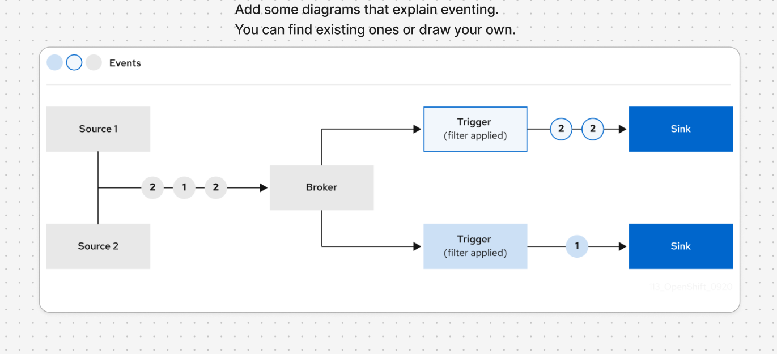
Co-design/Brainstorming - Implementation
Brainstorming Prompt Questions:

Slide 17
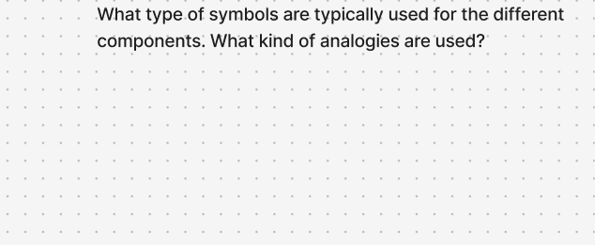
Co-design/Brainstorming - Implementation
Brainstorming Prompt Questions:
People had a hard time answering this question, maybe needs to be rephrased

Slide 18
Co-design/Brainstorming - Implementation
Two key ideas to running your own co-design/brainstorming session
Try to ensure a group with diverse experiences and backgrounds attend the session
Mix of experience levels is particularly important
Come up with good questions for the session
They should relate to ways to explain the concept you are trying to explain
They should be able to be answered by a person in only a few minutes
They should get people to explain the concept in different ways (words, visually, etc.)

Slide 19
Analogy - Implementation
From initial brainstorm, settled on mailroom analogy
Packages come in to a central broker, which then distributes them onto different conveyor belts which deliver the packages to each destination
Events: represented as packages to be delivered
Broker: represented as a large machine with a funnel to receive events
Triggers: represented as conveyor belts from the broker to a destination
Event Sinks: represented as boxes which could hold the packages that represent events
This was not a perfect analogy (the broker needs to make copies of the packages), but it explains many of the key concepts!

Slide 20
How can we turn our analogy into a more concrete representation?

Slide 21
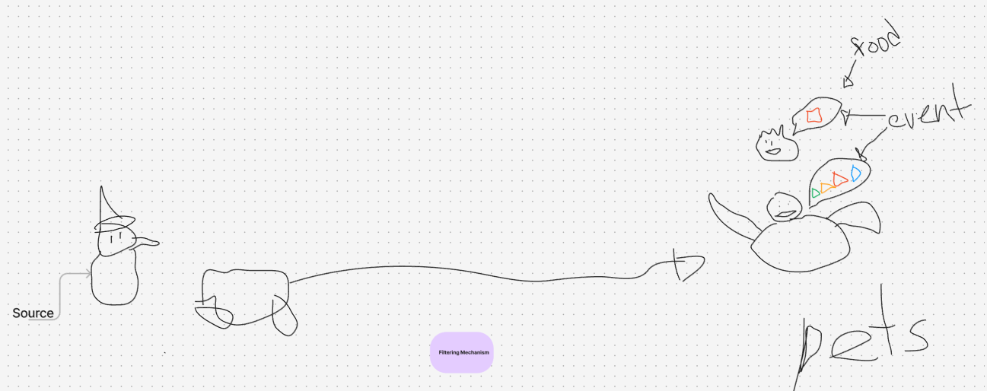
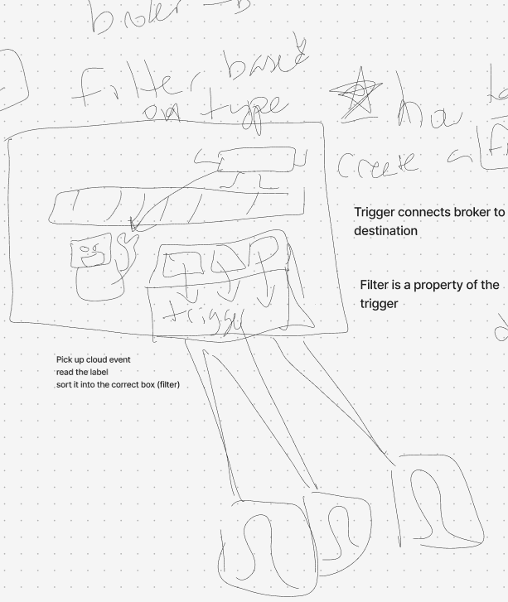
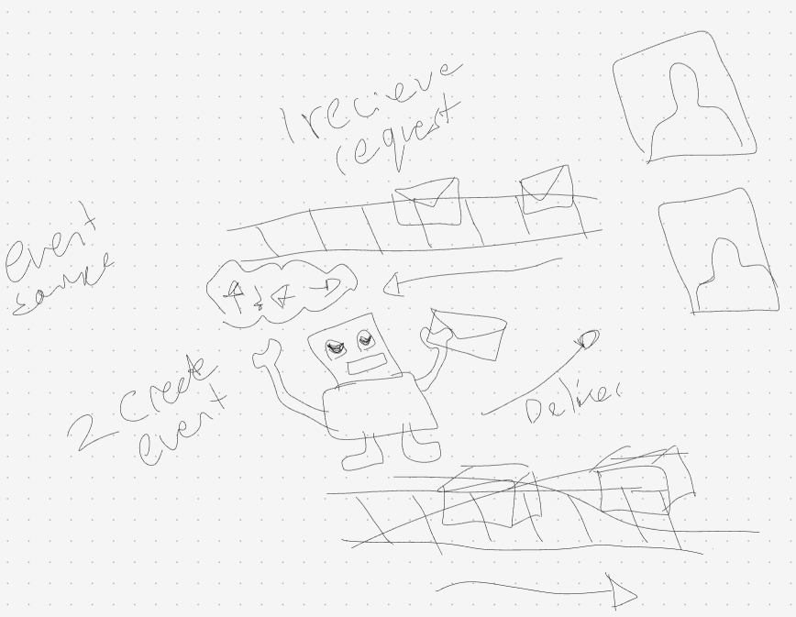
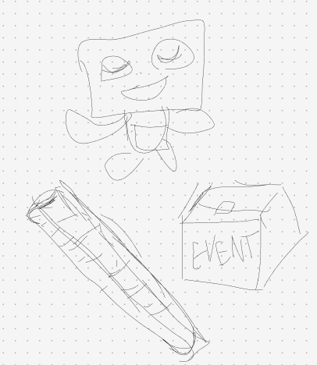
Prototypes- Initial Sketches
Held weekly meetings to develop the concept, used sketching to communicate ideas between group members
Took several weeks of brainstorming before finalizing the concept design

Slide 22
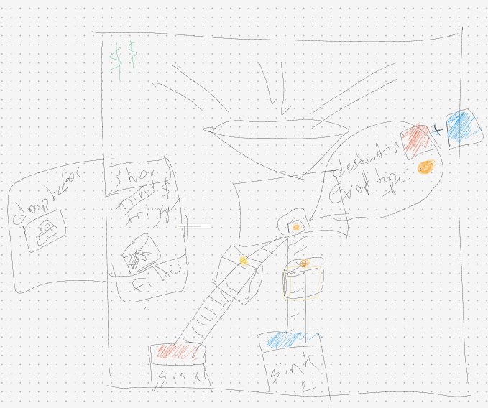
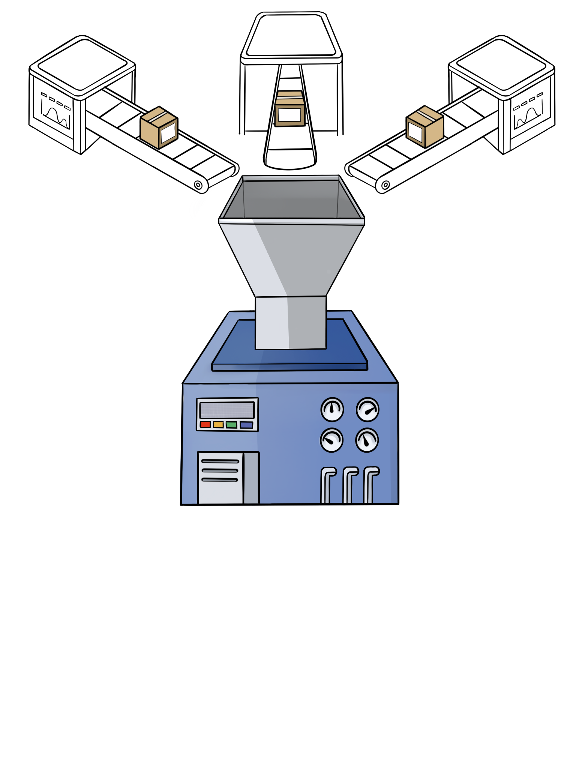
Prototypes- Initial Sketches
Low Fidelity Concept Sketch
High Fidelity Concept Sketch
Illustration by Shamayma Mobin

Slide 24
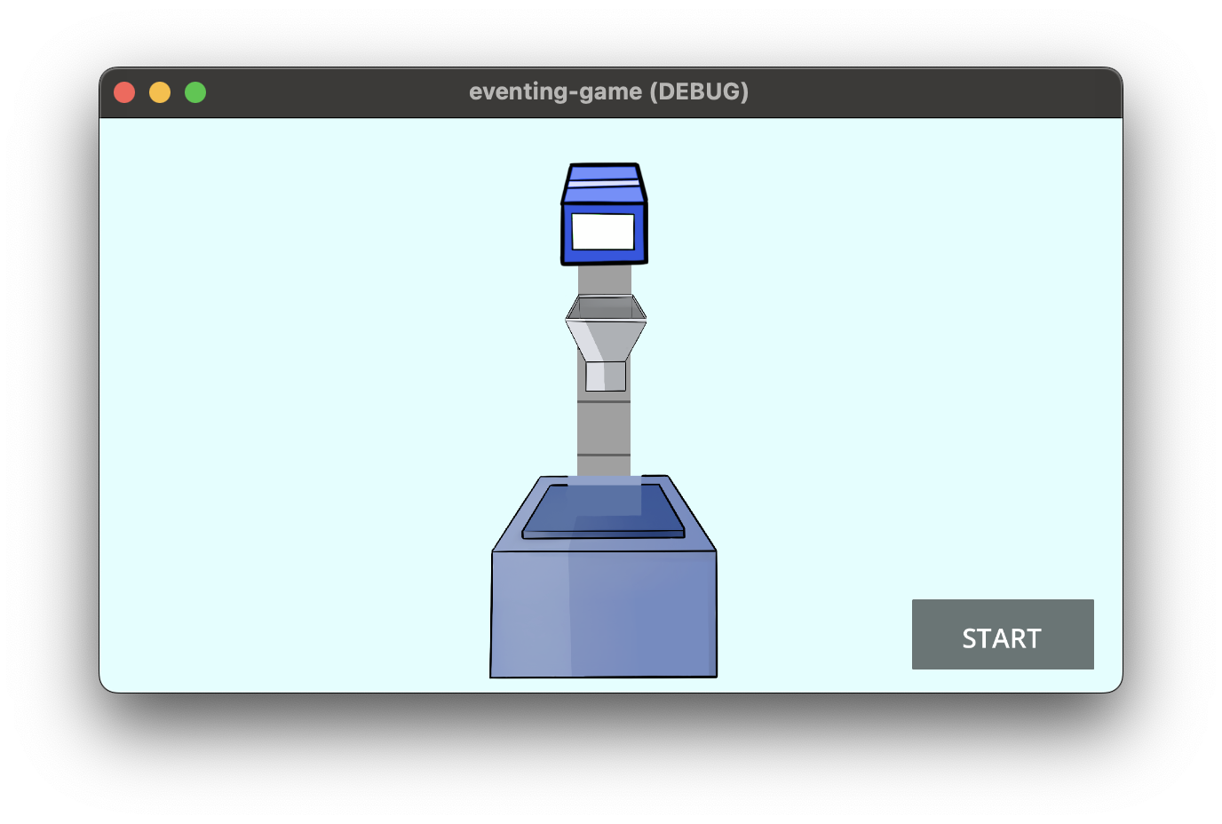
Design Process - Initial Prototype
First interactive version on godot
Games require a lot of designer <> developer collaboration
Developers often need assets from the designers
Designers have feedback on the current prototype
Have a weekly meeting to facilitate this
Can recruit game devs, or teach yourself game dev (lots of online resources)

Slide 25
Benefits
Engaging for students and first time contributors
People like video games and game dev!
Improves introduction to your project
Same information design techniques can be applied to different types of information displays (diagrams, GUI’s etc)

Slide 26
Contribute
Come contribute to Knative!
https://github.com/knative/community/blob/main/CONTRIBUTING.md
https://cloud-native.slack.com/archives/C07HR8V201L

Slide 27
Our Team
Angelina Zhai: https://www.linkedin.com/in/angelina-zhai/
Calum Murray: https://www.linkedin.com/in/calum-ra-murray/
Jamie Li: https://www.linkedin.com/in/soonalibersca/
Leo Li: https://www.linkedin.com/in/haocheng-leo/
Mariana Mejia: https://www.linkedin.com/in/mariana-mejia-design/
Pierangelo Di Pilato: https://www.linkedin.com/in/pierdipi/
Shamayma Mobin https://www.linkedin.com/in/shamayma-mobin-174542246
Zainab Husain: https://www.linkedin.com/in/zainabhusain1/

Slide 28
Sources
[1] M. Videnovik, T. Vold, L. Kiønig, A. Madevska Bogdanova, and V. Trajkovik, “Game-based learning in computer science education: a scoping literature review,” International Journal of STEM Education, vol. 10, no. 1, p. 54, Sep. 2023, doi: 10.1186/s40594-023-00447-2.
[2] C. Evans and N. J. Gibbons, “The interactivity effect in multimedia learning,” Computers & Education, vol. 49, no. 4, pp. 1147–1160, Dec. 2007, doi: 10.1016/j.compedu.2006.01.008.
[3] J. Denner, L. Werner, and E. Ortiz, “Computer games created by middle school girls: Can they be used to measure understanding of computer science concepts?,” Computers & Education, vol. 58, no. 1, pp. 240–249, Jan. 2012, doi: 10.1016/j.compedu.2011.08.006.

